Slide 1


Presentation
GYM Project

Slide 2
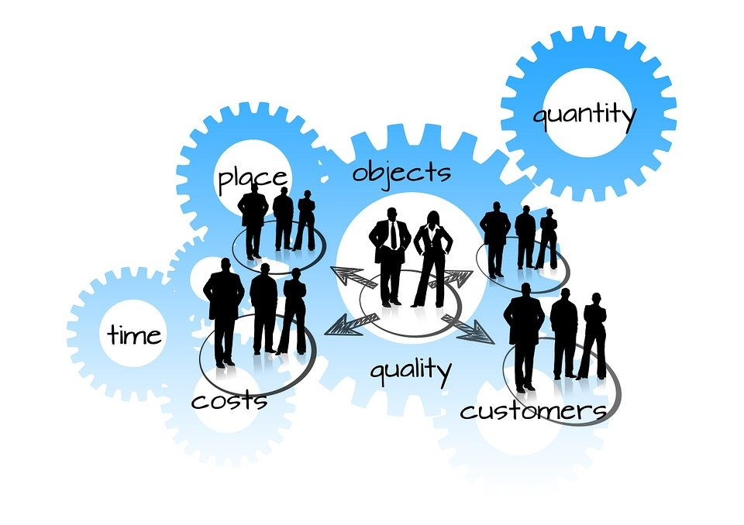
Project objective
Create an application that helps manage the users of a Gym and use it to review the calendar and activities.
This gym management system has the purpose to help to manage the information regarding clients, payments, and details of the organization in a simple and systematic way so there is a control of the information and tools to manipulate the information in a way that the workflow is smooth.

Slide 3
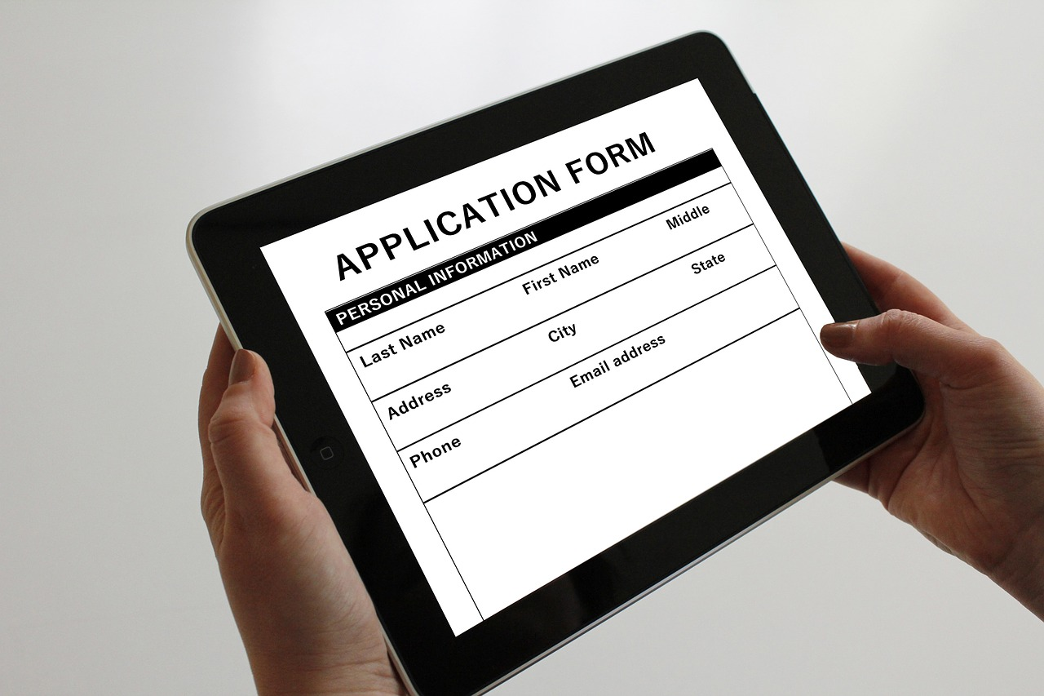

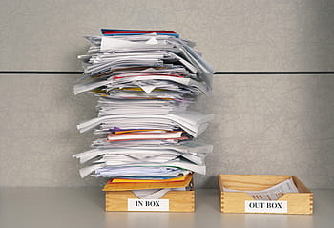
User History
As a < type of user >
Who are we building this for?
Administrator Gym
AS A < some goal>
Manager want
Avoid paperwork
As a <benefit>
Why do they want to achieve this?
Share the same information in different places all in one app

Slide 4
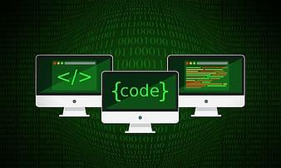
Software used
New Technologies:
Big calendar
Moment
html5-qrcode
Technologies / Frameworks:
Bootstrap
Node
React
MySQL
Heroku
Passport
JQuery / Ajax
Express
DOTENV

Slide 5
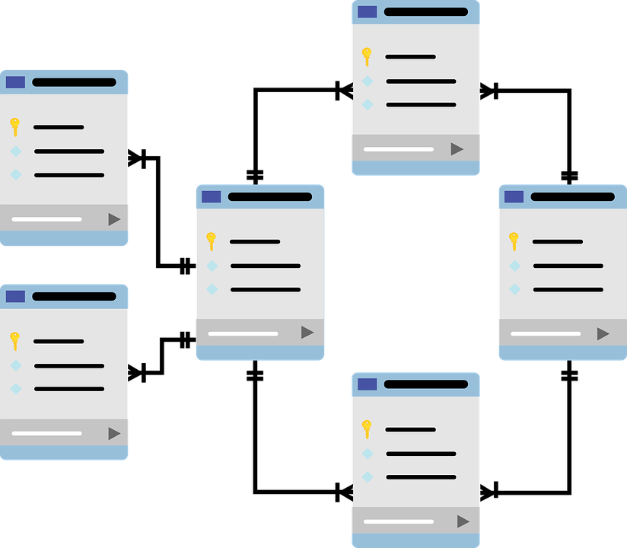


Initial design
DB
GitHub-Luis
APP-HEROKU
GitHub-Rake
SERVER
GitHub-Arturo
CLIENT

Slide 6
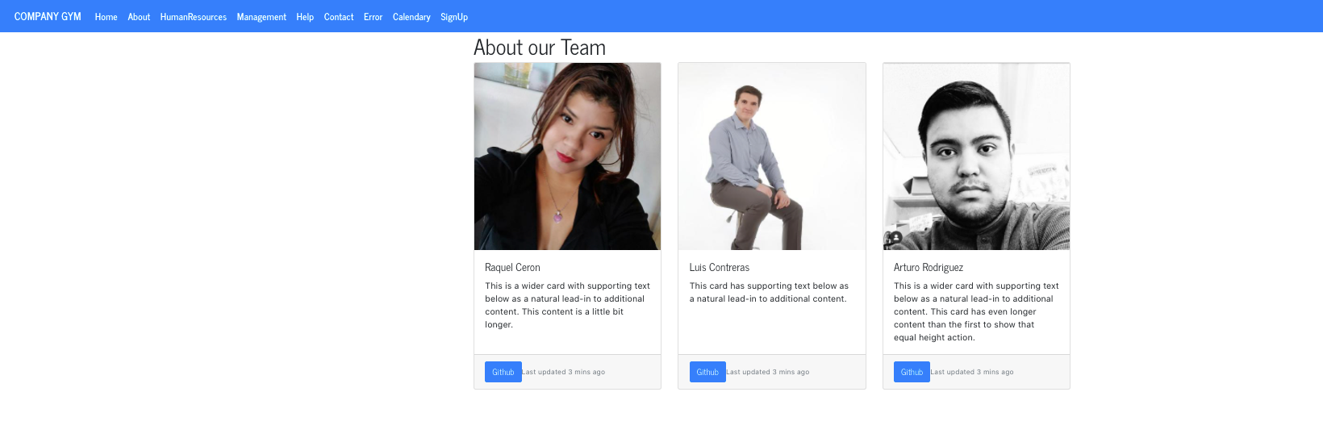
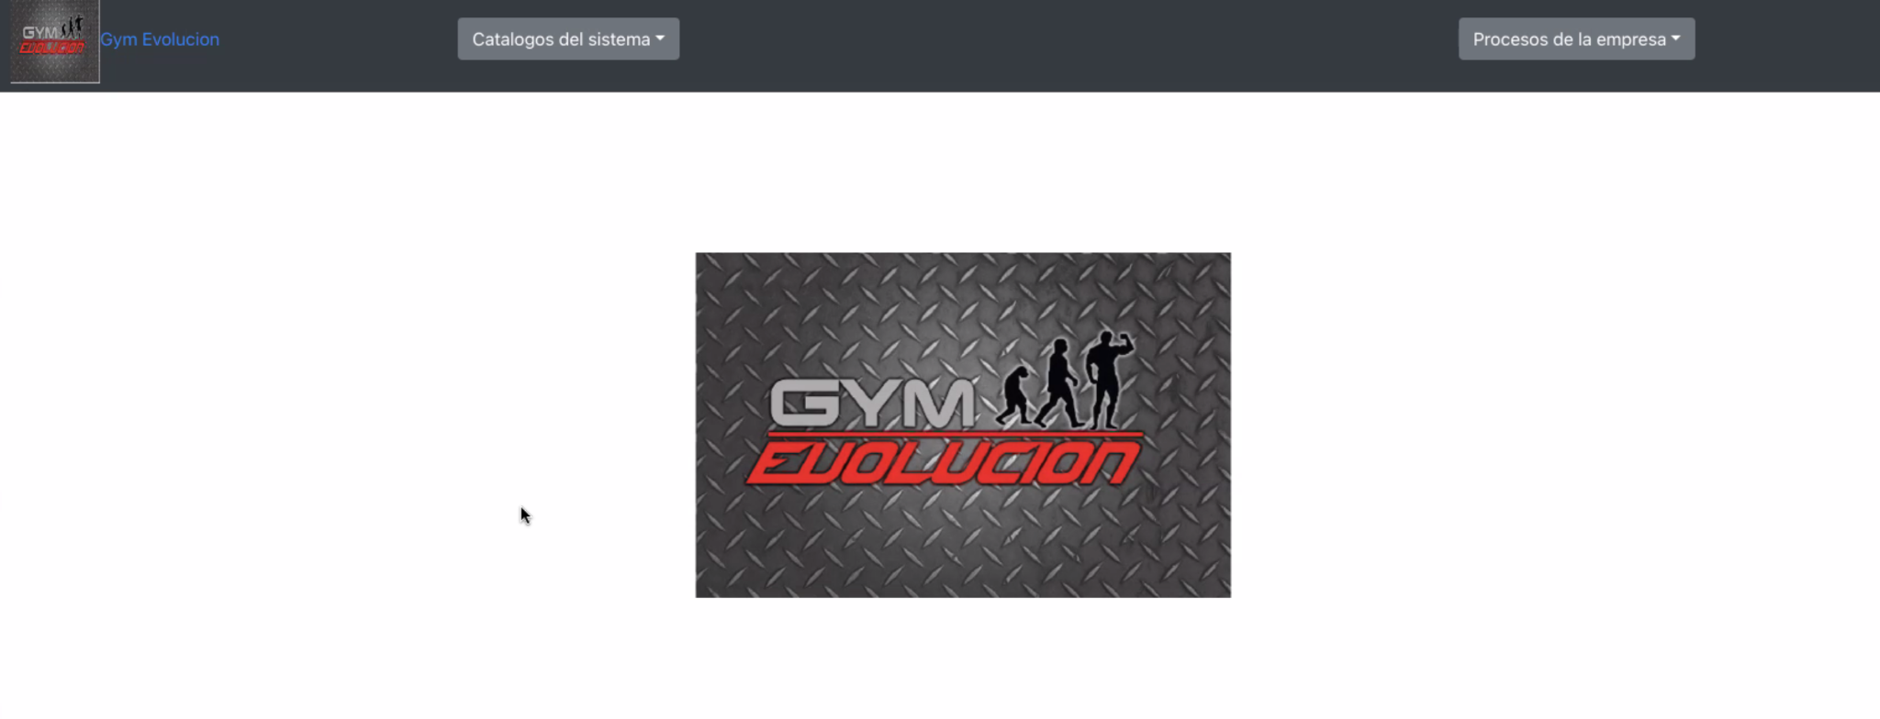
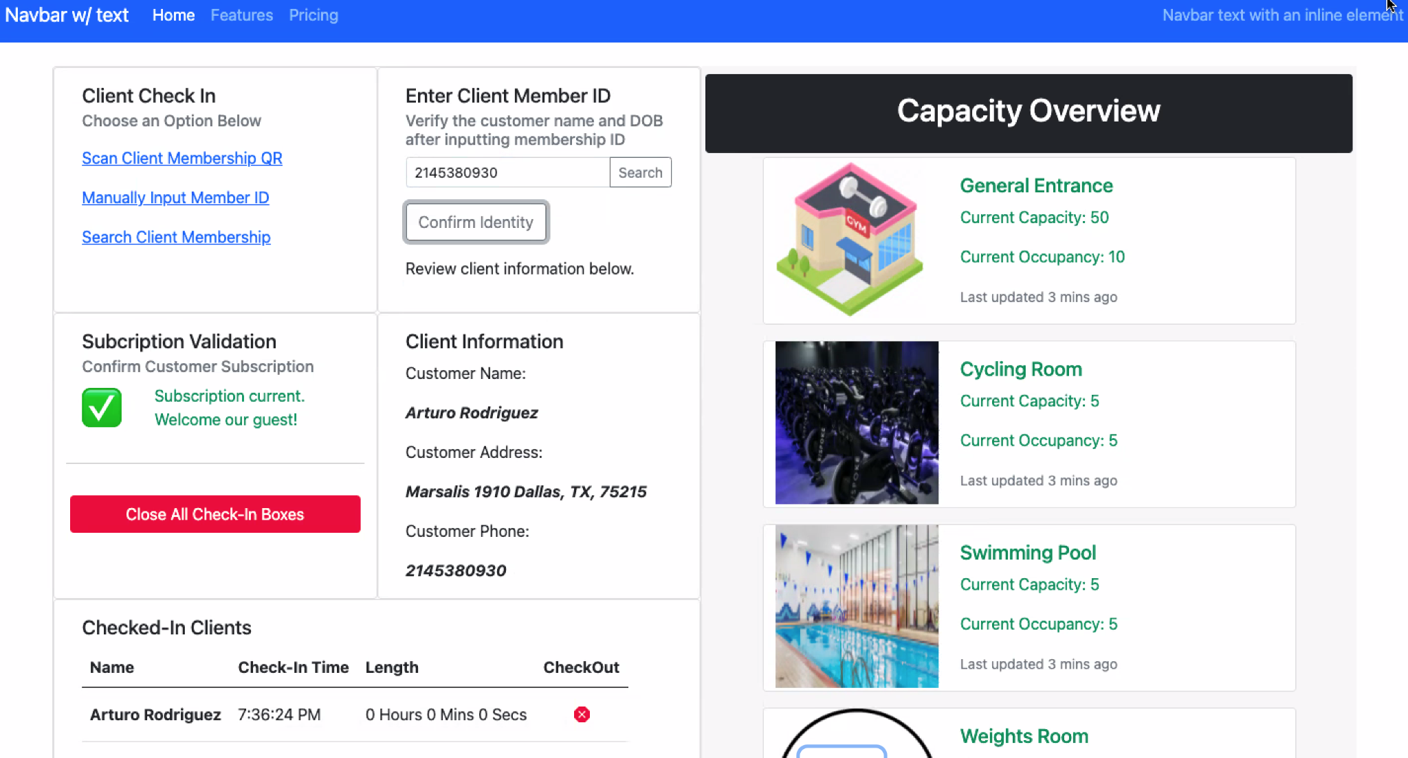
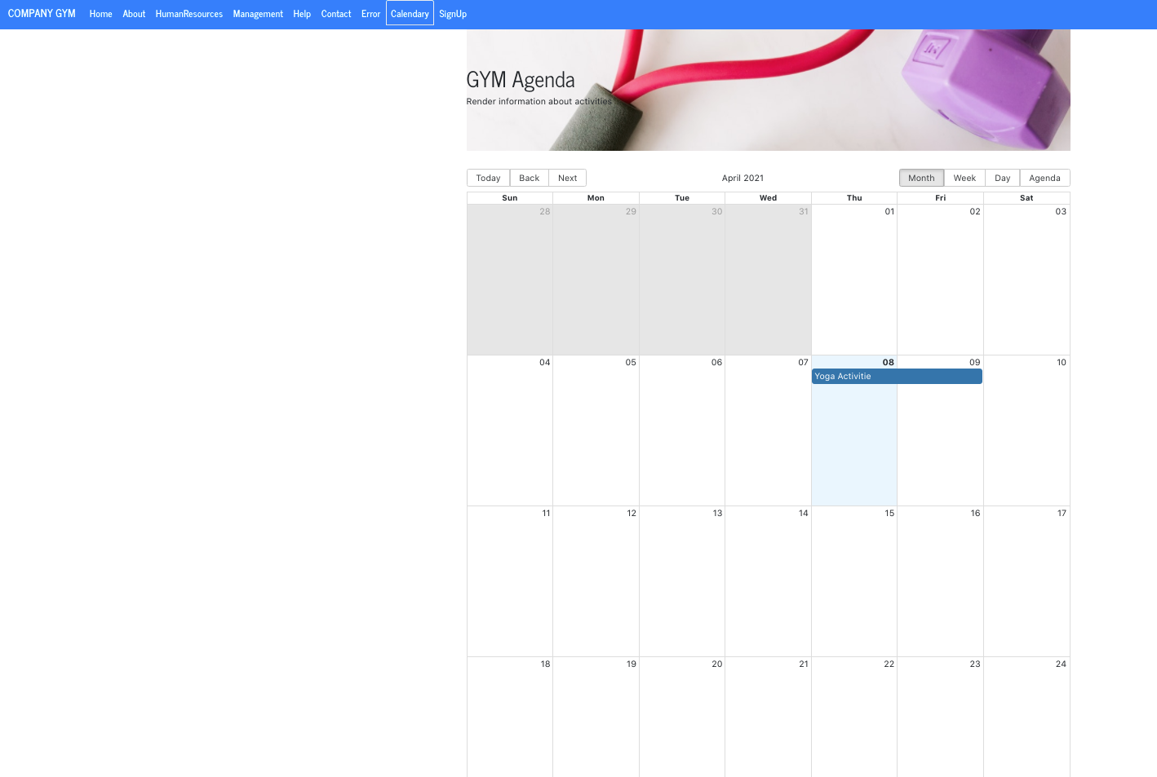
Initial Idea
Minimum Viable Product
Product Vision:

Slide 7
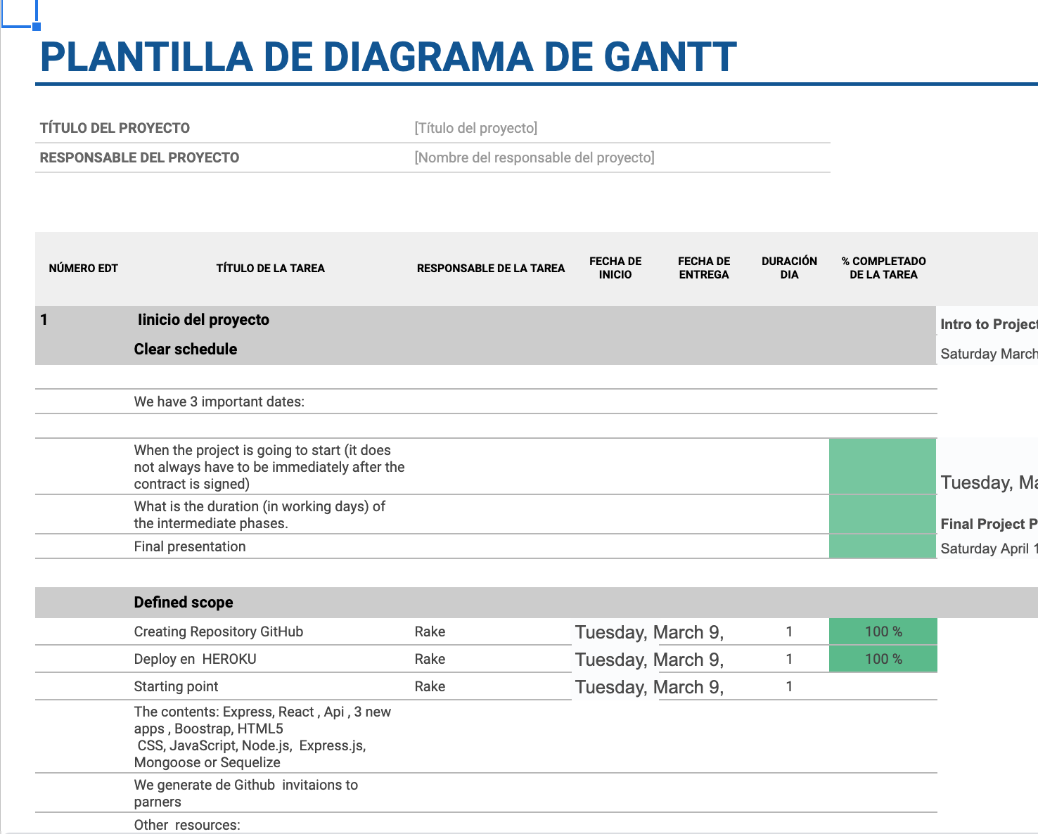
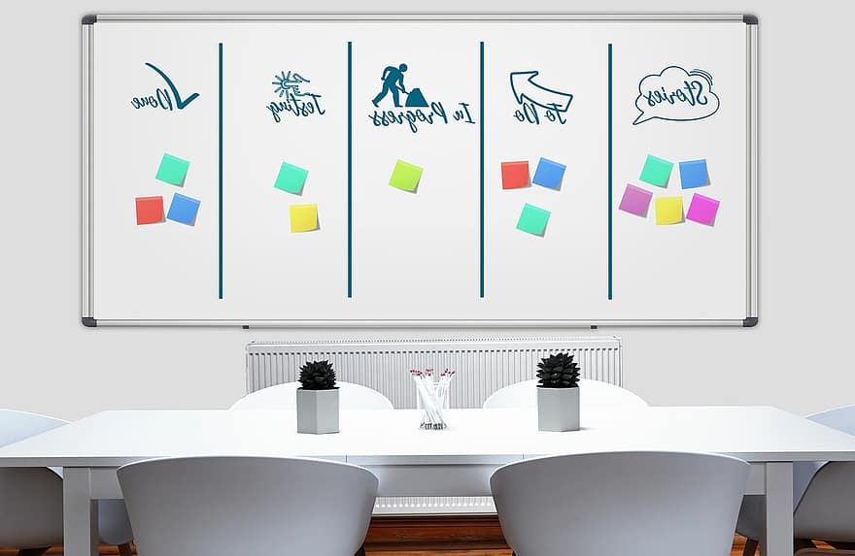
Project Management

Slide 8
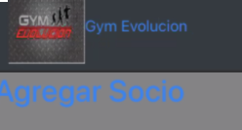
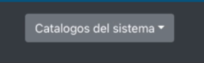
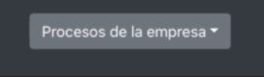
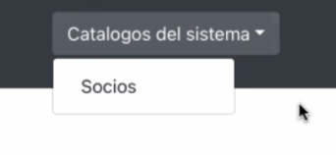
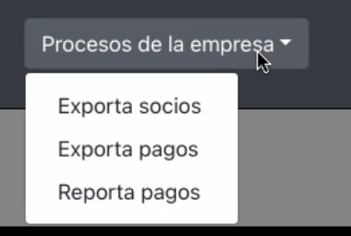
How to guide

Slide 9
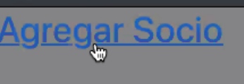
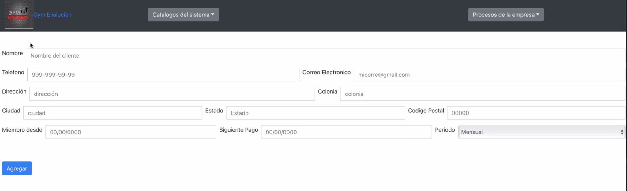
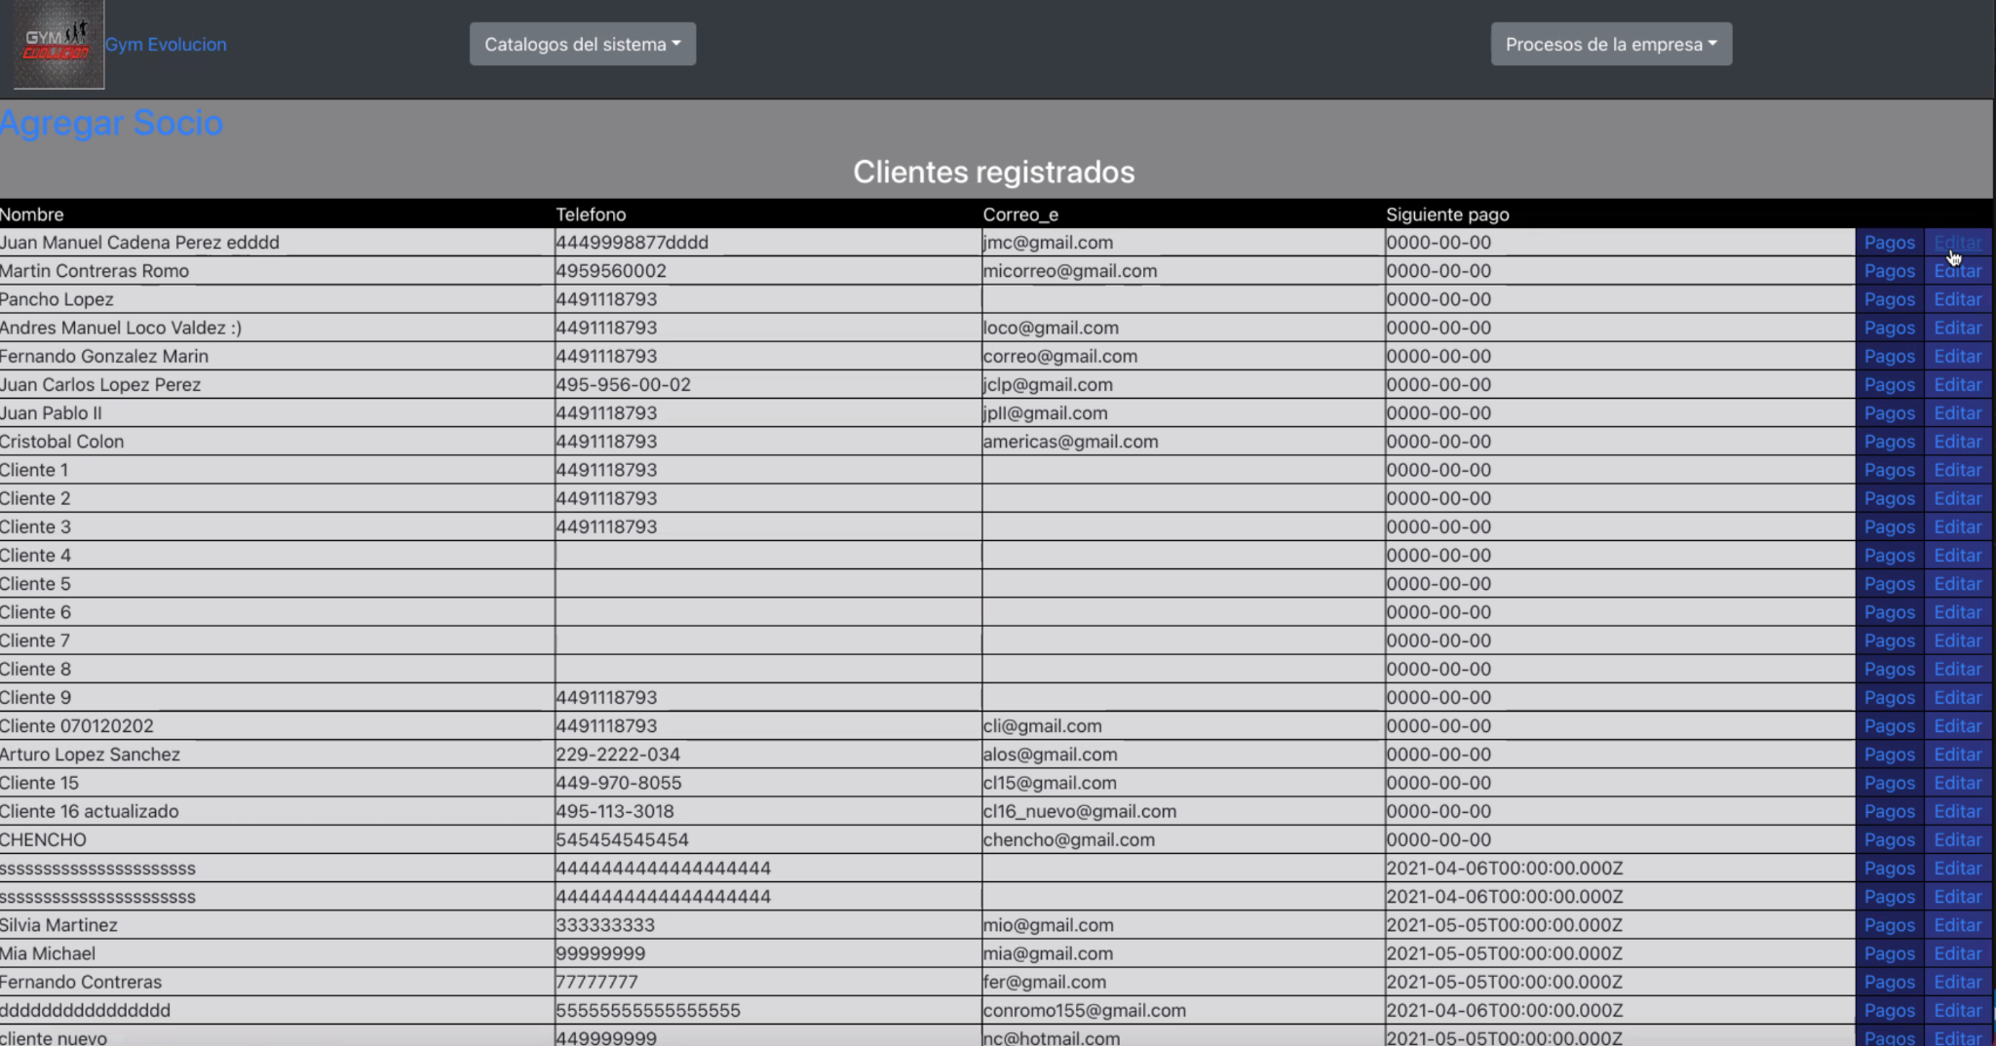
Add User

Slide 10
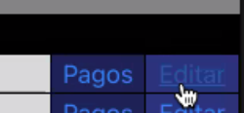
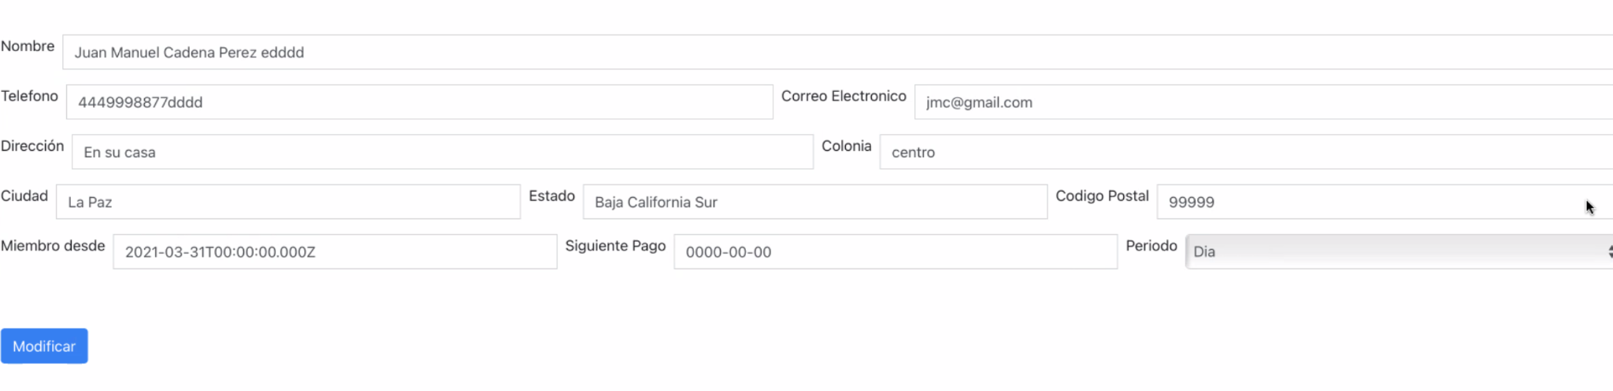
Edit User

Slide 11
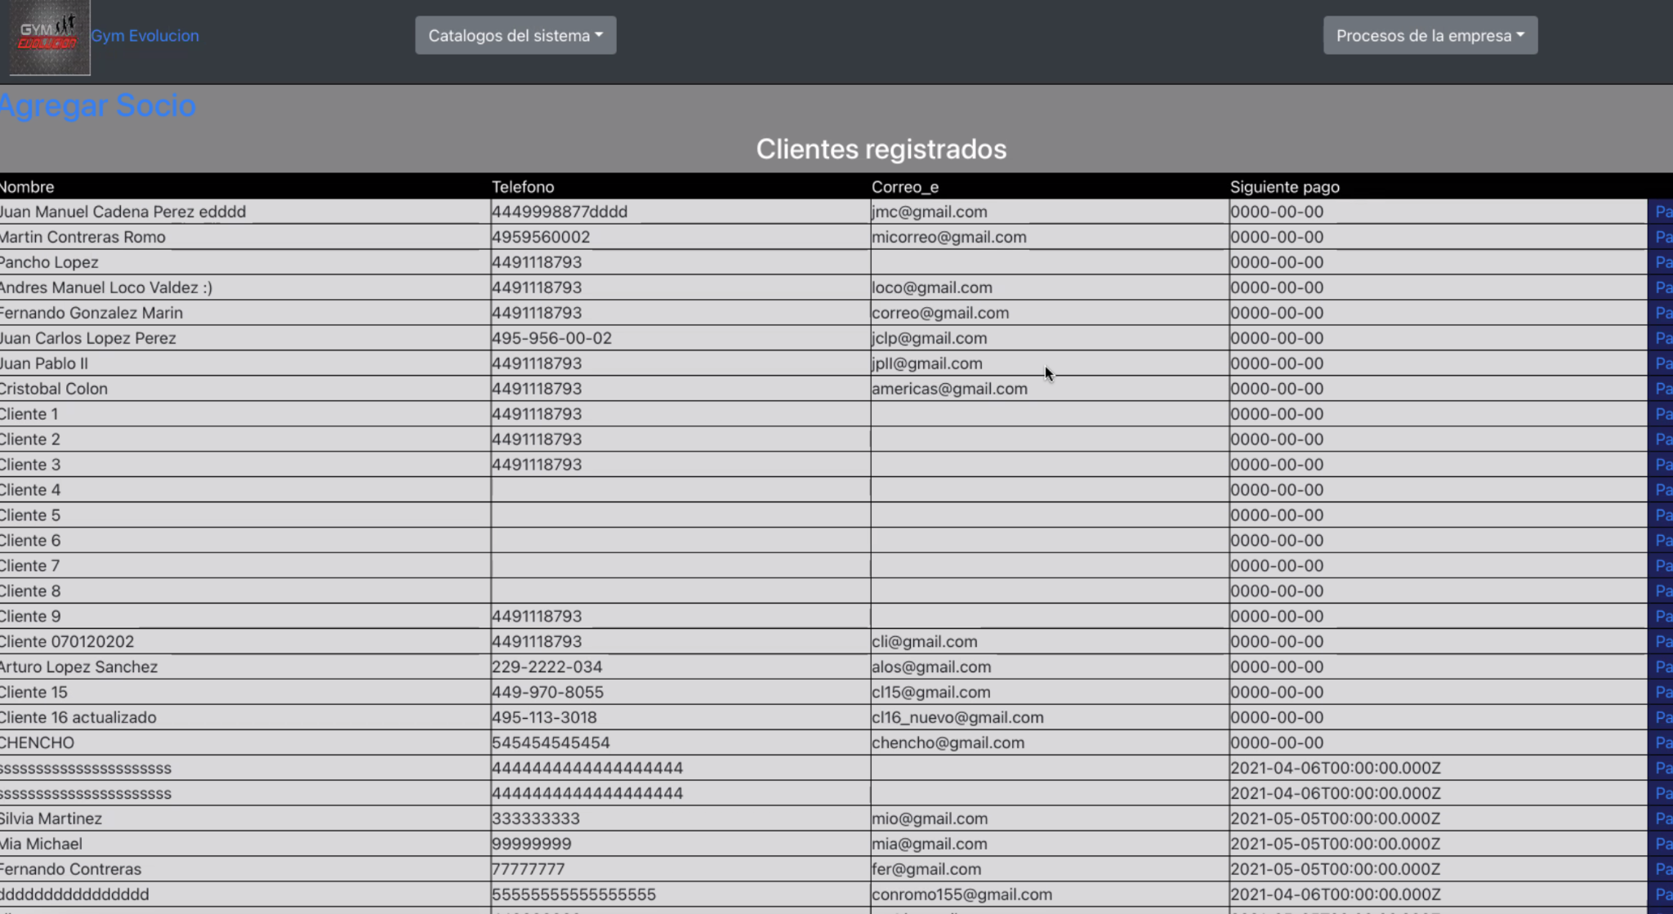
DB

Slide 12
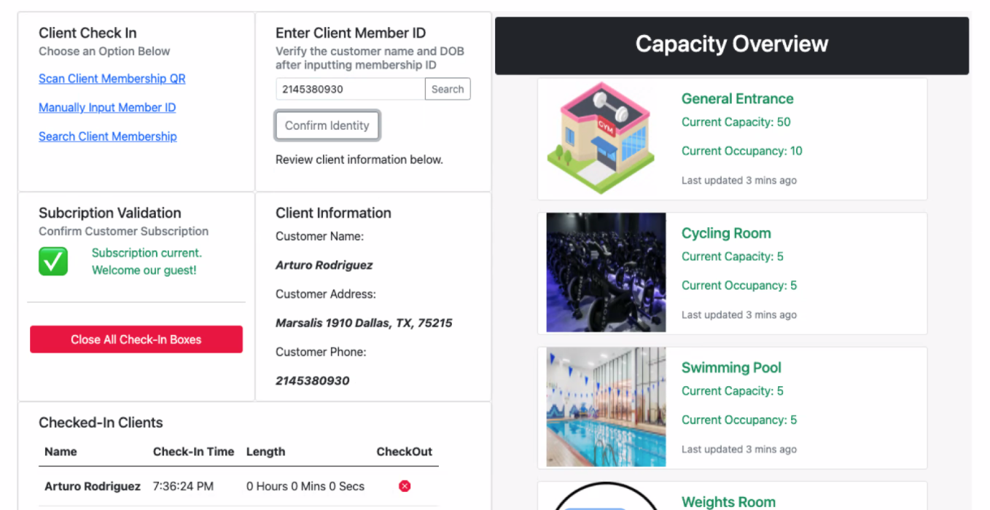
Process
Check in
Capacity

Slide 13
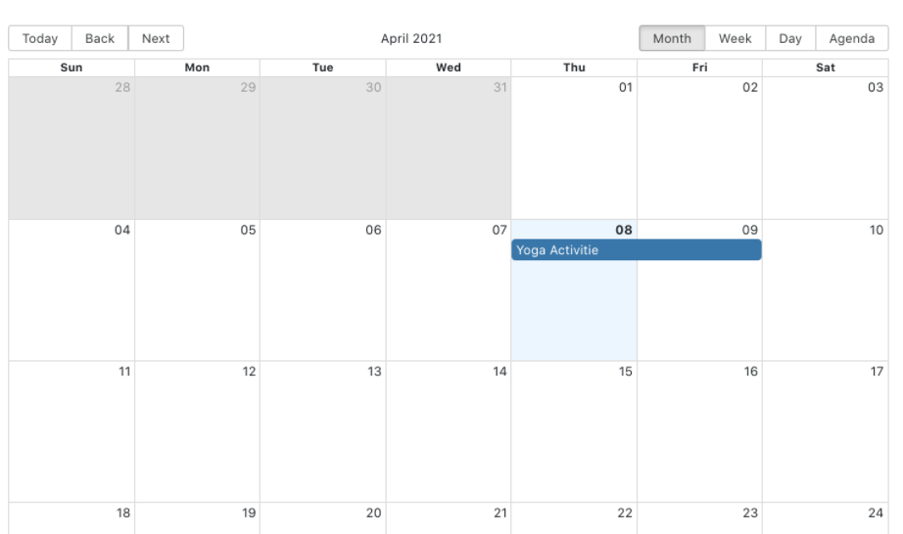
Calendar

Slide 14

Utility
The application has different modules to work with the data, you can see the users that are on the gym, add new users that will register and capture their data, edit existing users, and check on their payments, and you also get the option to export information in a beautiful table format so you can take that data and move it to the application of choice to take reports and handle it.
It helps to improve the general experience of managing information for the administrator that works on the GYM.

Slide 15
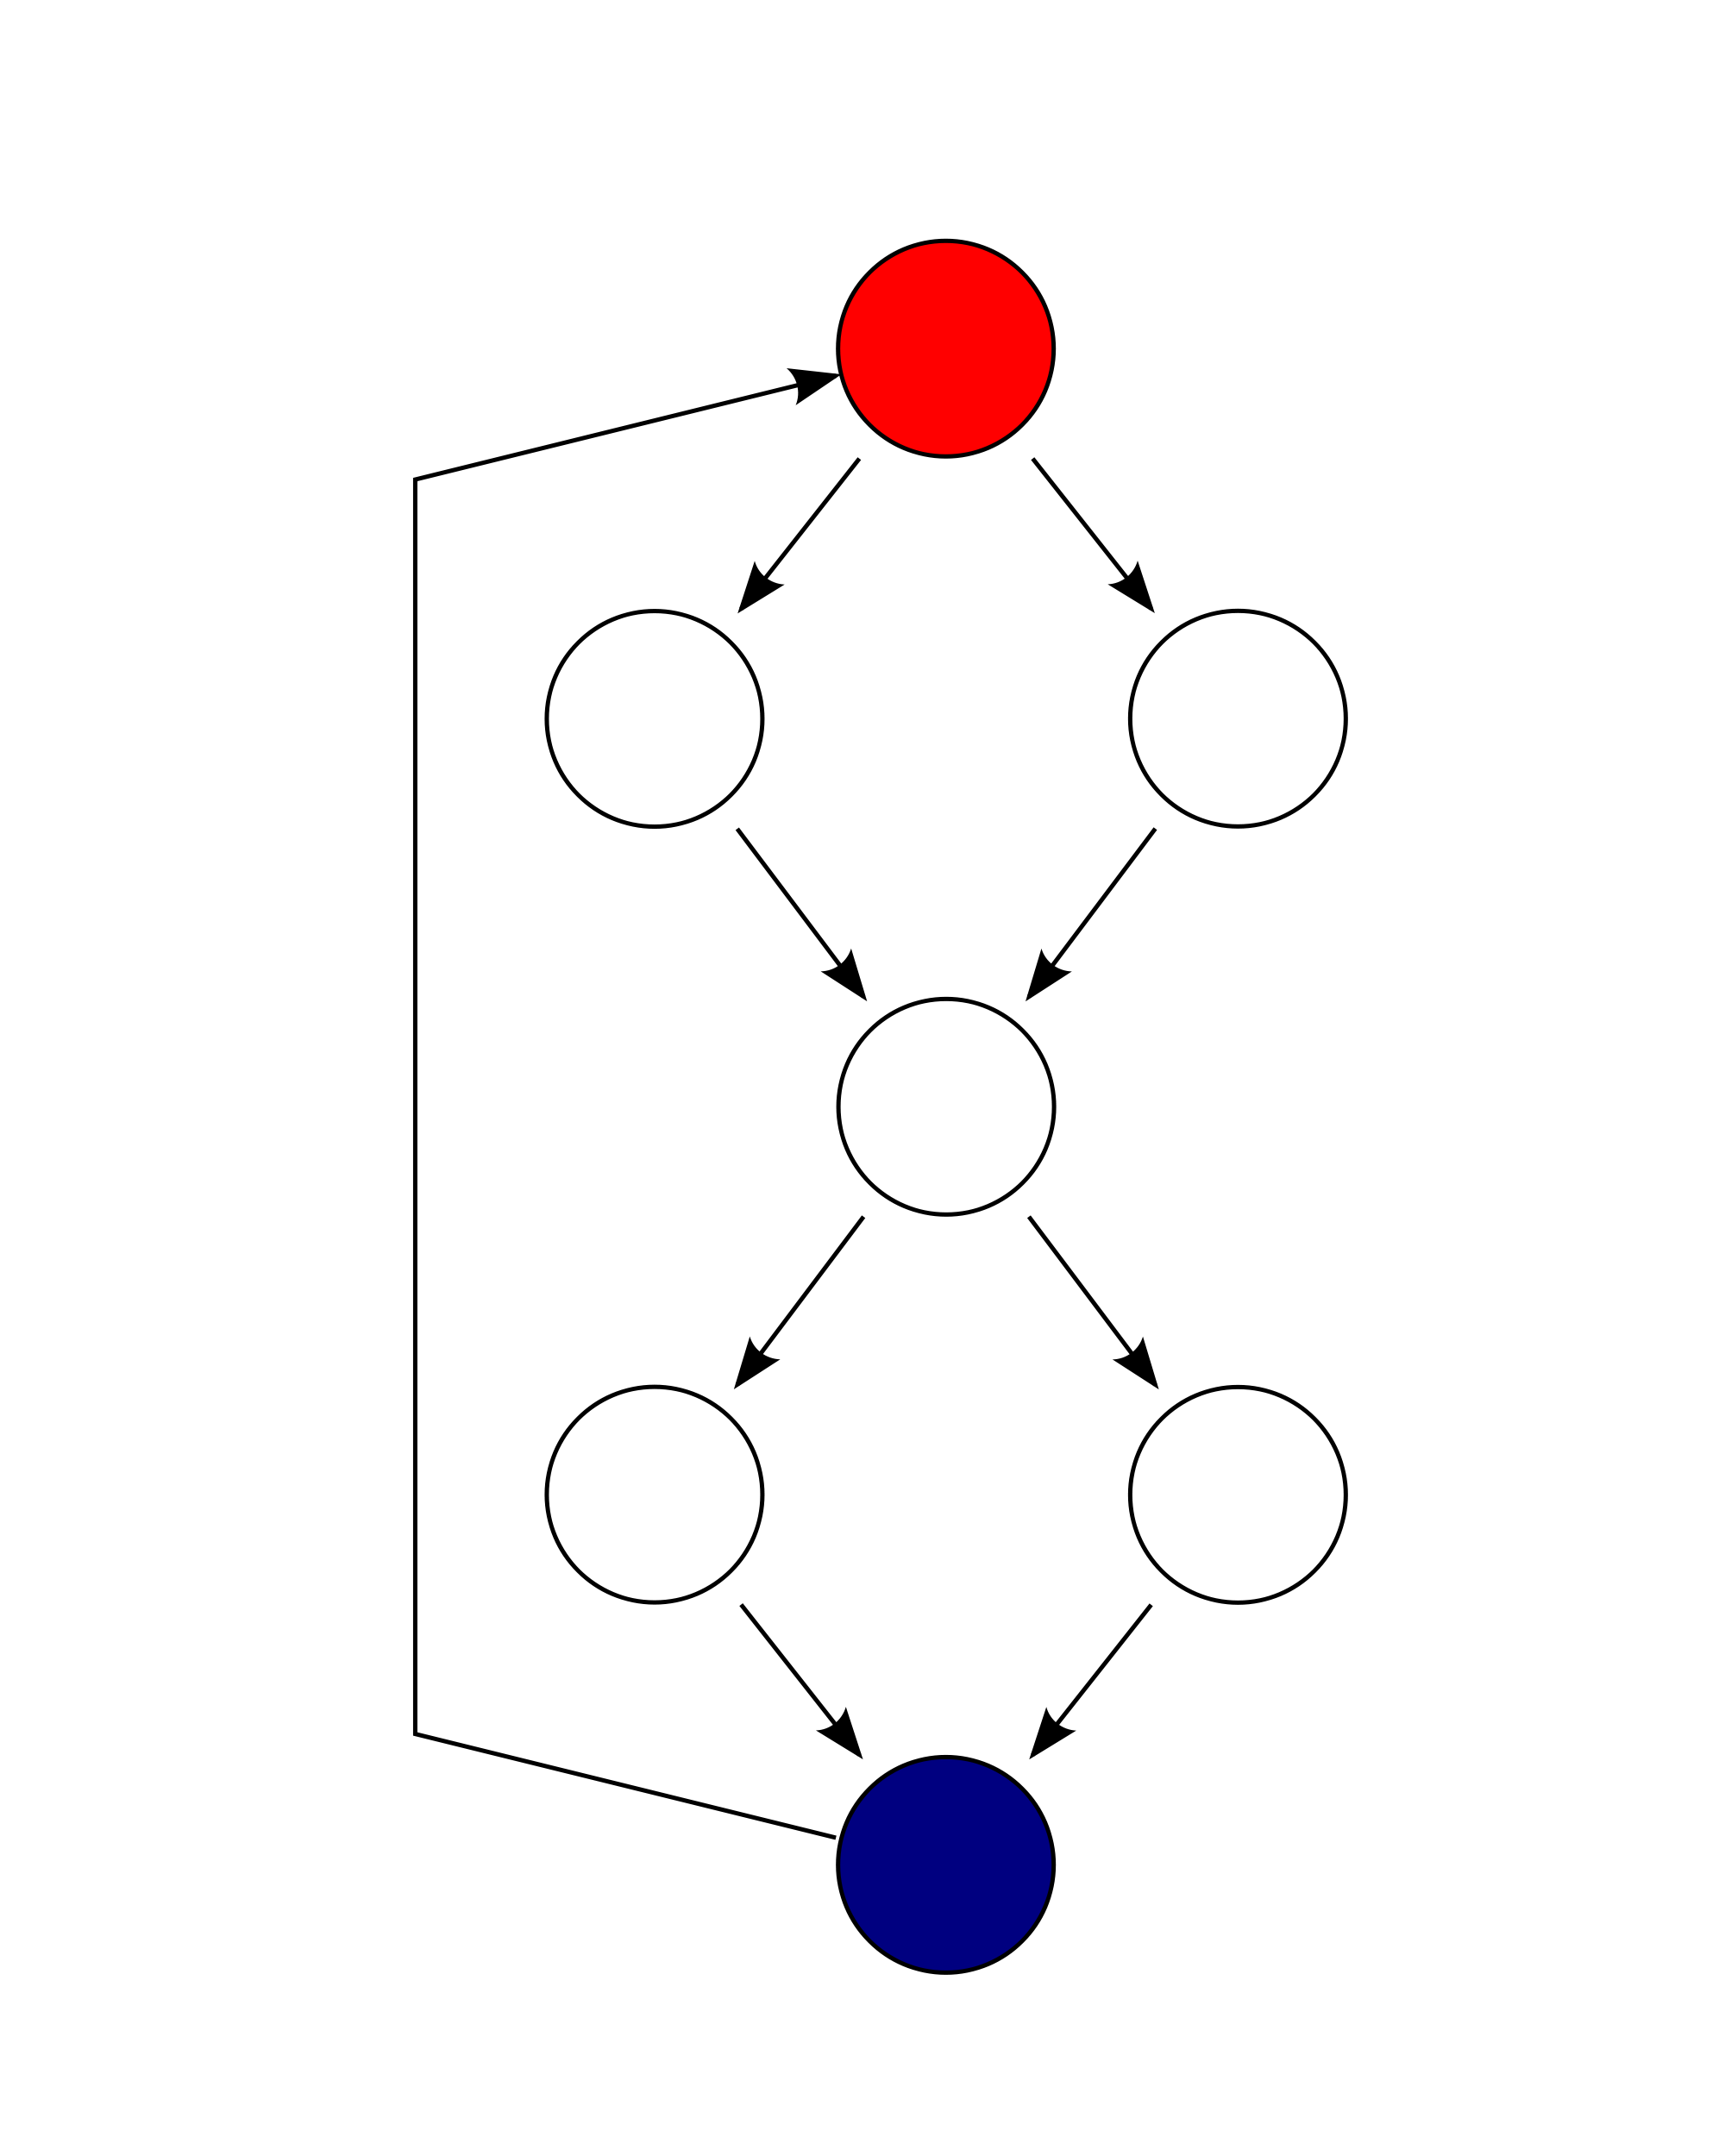

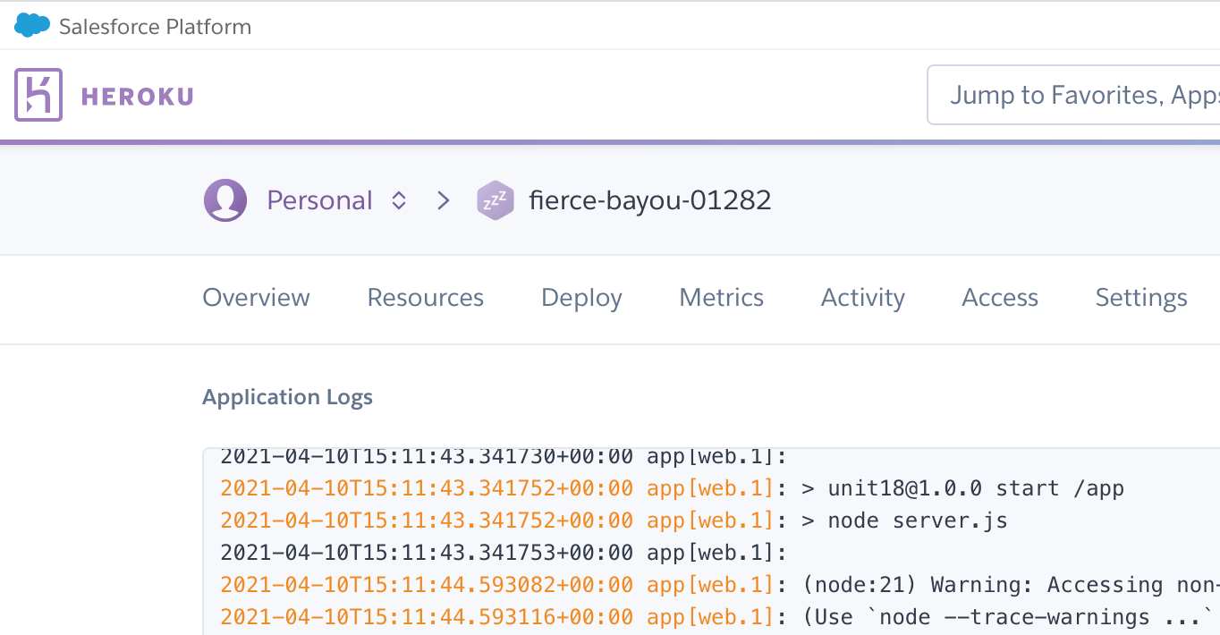
Challenges
Github problem
Assign Tasks,
Put Separate Code Together,
Call DB,
Use Github.
Using new software

Slide 16
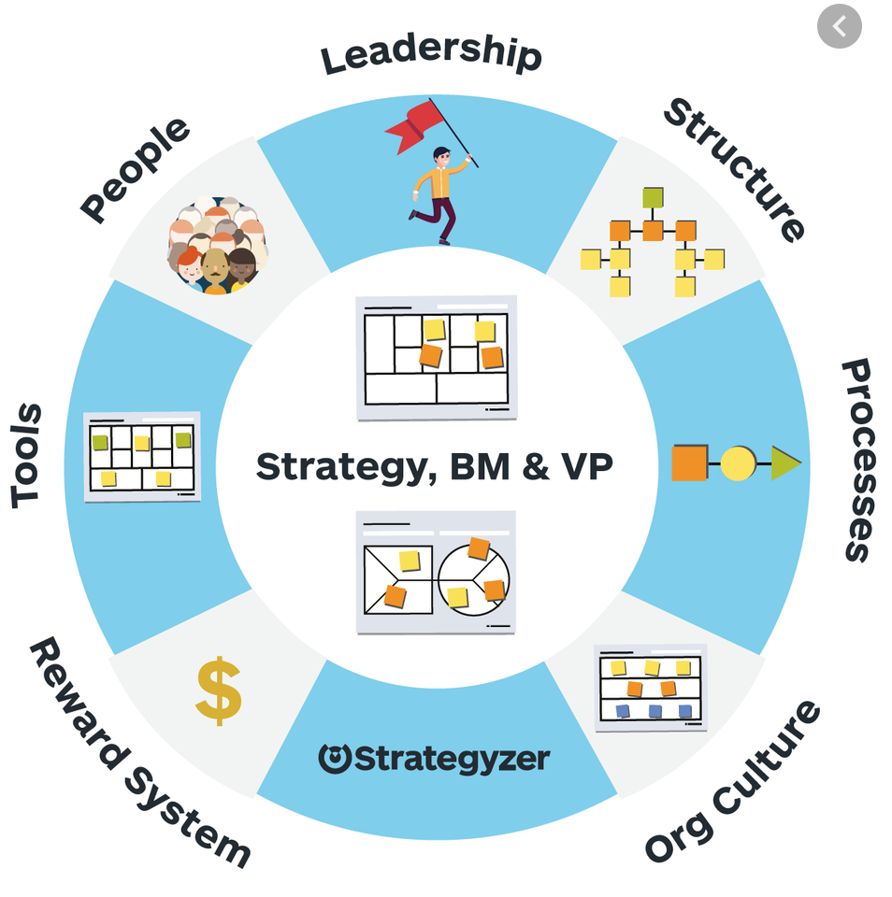
Future Development
This application has a lot of opportunities to grow since it not only can be used for a GYM but it can also be adapted for any other business that needs to handle their information in a better way.
It has also possibilities to add modules for managing not only users and clients data but also products and inventory which would make this a even better tool for the organizations.
Help manage new resources in company

Slide 17
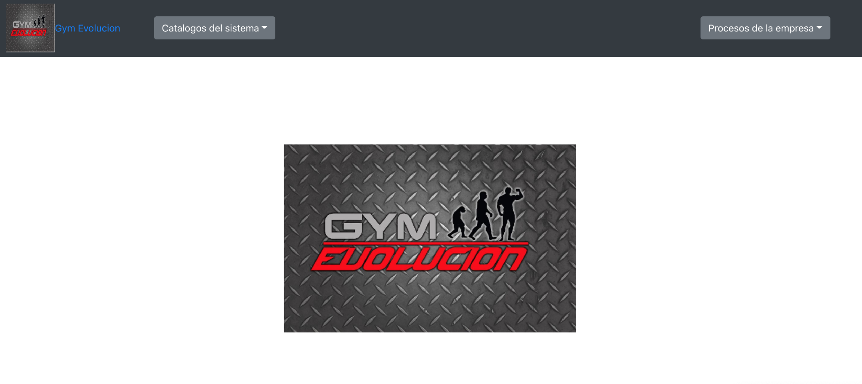
Demo
https://github.com/LuisContrerasGlz/ngym_client
https://gymevolucionclient.herokuapp.com/

Slide 18


